Slide 1



Advance QTP / Object
Recognition
NHS Automation Team

Slide 2
Agenda
Advance QTP / Object Recognition
Runtime Objects & Test Objects
Descriptive Programming
Regular Expression
Object Identification
Custom Replay Solution / Tips & Tricks
Questions

Slide 3
Test Objects & Runtime Objects
Advance QTP / Object Recognition
Test Objects (TO)
Run-Time Objects (RO)
Used by QT to represent objects in AUT
TO property set created and maintained by QT, captured from AUT during recording
Based on runtime object properties, but not necessarily 1-1 mapping
QT uses stored TO properties to identify AUT objects during test run
Access TO properties using GetTOProperty
Access TO methods directly
Actual live objects in AUT
RO property set created and maintained by AUT, ‘queried’ from RO by QT
Access runtime property values (runtime value of property defined by QT) using .GetROProperty
Access native object properties using .Object
Access native object methods using .Object

Slide 4
Descriptive Programming
Creating Tests without Object Repository
Advance QTP / Object Recognition
Using programmatic descriptions we can perform an operation on an object that is not stored in the Object Repository.
Types of Programmatic descriptions:
a) We can list the set of properties and values that describe the object
directly in a test statement.
e.g: Dialog(“name:=Login”).WinEdit(“attachedtext:=agentname”).Set”impetus”
b) We can add a collection of properties and values to a description object
and then enter the description object in the statement.
Set myobject=Description.Create()
myobject(“attachedtext”).value:=“agentname”
myobject(“html tag”).value:=“a”
Dialog(“name:=Login”).WinEdit (myobject).Set”impetus”

Slide 5
Descriptive Programming (Contd….)
Advance QTP / Object Recognition
To interact with Test Objects not stored in the Object Repository
You can also instruct QTP to perform methods on objects without
  referring without referring to the object’s logical name in the object
  repository. To do this you provide QTP with a list of properties and
  values that QTP can use to identify the object or objects on which
  you want to perform a method

Slide 6
Descriptive Programming (Contd….)
Advance QTP / Object Recognition
You can describe an object directly in a test statement by specifying property : = value pairs describing the object instead of specifying an object’s logical name.
Syntax:-
TestObject(“PropertyName1:=PropertyValue”, “…”,
“PropertyNameX:=PropertyValueX”)
Where “Test Object” is test object class
PropertyName is PropertyValue
i.e. the test object property and its value .

Slide 7
Descriptive Programming (Contd….)
Advance QTP / Object Recognition
Each property:= value pair should be separated by commas and quotation marks.
For Ex:- Window(“Title:=Myfile”,“Text:=Myfiletxt).Move 50,50
If you want to use the same programmatic description several times in one test, you may want to assign the object you create to a variable.
For Ex:- Set MyWin := Window(“Title:=Myfile”,“Text:=Myfiletxt)
MyWin.Move 50,50

Slide 8

Descriptive Programming
Advance QTP / Object Recognition
Description.Create returns a Properties collection object, which you can then use in place of an object name in a statement.
You can add, edit and remove properties as with any collection.
Note that .ChildObjects requires a description object parameter.
See “Enhancing Your Tests with Programming” in the QuickTest 6.5 User Guide for more information.
When using programmatic descriptions from a specific point within a test object hierarchy, you must continue to use programmatic descriptions from that point onward within the same statement.
Wrong Usage : Browser(Desc1).Page(Desc2).Link("Example1")
Correct Usage : Browser(Desc1).Page(Desc2).Link(Desc3)
Tip: GetTOProperties returns a collection of properties, which can be modified and later used as programmatic description
Can’t Stop Once You’ve Started

Slide 9
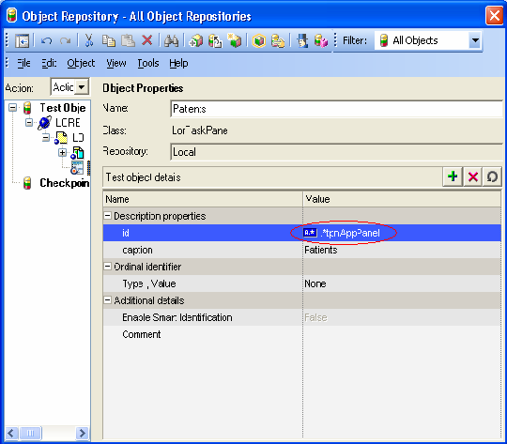
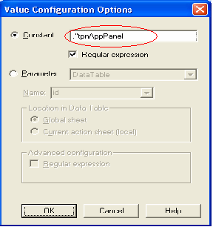
Regular Expressions
Advance QTP / Object Recognition
Regular Expressions enable Quick Test to Identify Objects and text strings with varying values.

Slide 10
Regular Expressions
Advance QTP / Object Recognition
A Regular Expression is a string that specifies a complex search phrase. By using special characters, you define the conditions of the search.
From the Object Repository Properties window, ensure Constant is enabled and click on the note paper icon.
Check Regular Expression checkbox.
Add the regular expression. For example, using wildcard characters we
coined the Id property to “.*tpnAppPanel” instead of
“itaskpane_Control_tpnAppPanel”, the particular “itaskpane_Control_” it does not remain constant.
We can also create some RE patterns like to check only for alphabets, [A-Z a-z]+.

Slide 11
Object Identification & Smart Identification
Advance QTP / Object Recognition
QTP identifies run-time objects based on TO properties whose values are compared with the RO values
Recorded Mandatory + Assistive properties become mandatory object description used during replay
Smart Identification used when the object can’t be identified (during replay only)
Smart Identification is only invoked during replay, if enabled for the particular object class.
During the recording phase QTP records properties for Smart Identification, but doesn’t use them until Smart Identification is invoked
Smart Identification is an algorithm used by QTP when it is not able to recognize one of the object.

Slide 12
Smart Identification
Advance QTP / Object Recognition
Properties for Smart ID are recorded, but not used during replay
When Smart ID is invoked, QT uses the properties that were recorded to identify the object
Base and Optional Filter properties for Smart Identification must be set beforehand (so that QTP knows to record them).
You can not set these properties retroactively
Use only if required. Because QTP has to record more properties, enabling Smart Identification degrades performance

Slide 13
Smart Identification
Advance QTP / Object Recognition
Configuring Smart Identification
Tools → Object Identification
Disable for specific object
Disable for test run
Temporarily disable Smart Identification during replay
Set App = CreateObject("QuickTest.Application")
App.Launch
App.Test.Settings.Run.DisableSmartIdentification = True
…
App.Test.Settings.Run.DisableSmartIdentification = False
Smart Identification in Test Results
Smart Identification Warning in Test Results

Slide 14
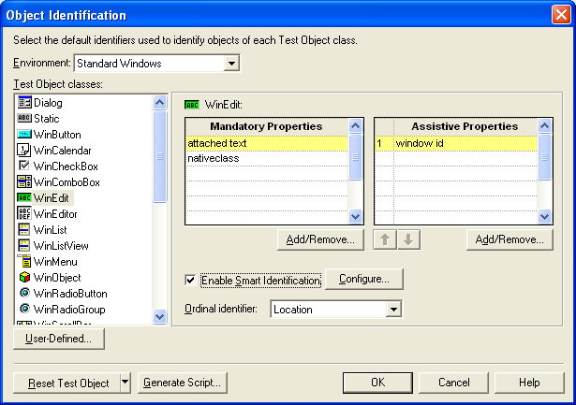
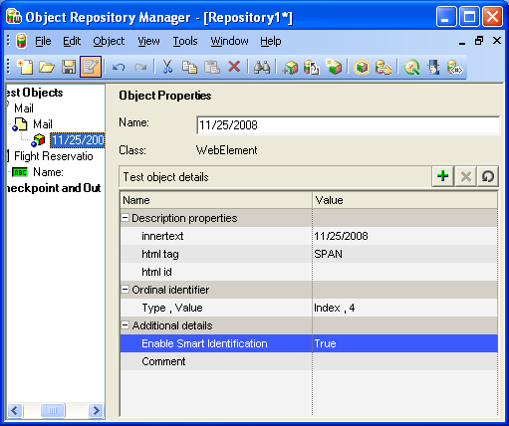
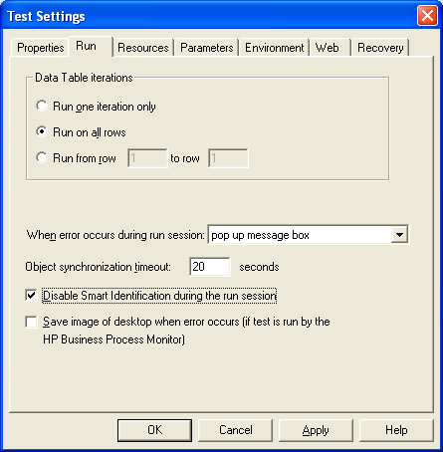
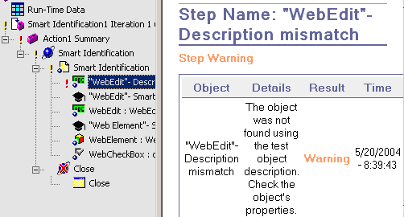
Smart Identification
Advance QTP / Object Recognition

Slide 15
Custom Replay Solution
Advance QTP / Object Recognition
“Mercury.DeviceReplay” - object allows you to perform mouse
operations
“wscript.shell” - Alternative way to perform keyboard operations
http://msdn.microsoft.com/library/default.asp?url=/library/en- us/script56/html/wsmthsendkeys.asp
RegisterUserFunc allows you to overwrite methods or add new
method to an existing Test Object
Replay Types ( Web Only )

Slide 16
Custom Replay Solution
Advance QTP / Object Recognition
When replay using events fails – temporarily change ReplayType (Web only)
  Setting.WebPackage("ReplayType") = 2 ‘ Mouse Replay
  Browser(“Browser”).Page(“Page").WebButton(“Button").Click
  Setting.WebPackage("ReplayType") = 1 ‘ Event Replay
  1 - Runs mouse operations using browser events
  2 - Runs mouse operations using the mouse
  Don’t forget to change Replay Type back to its previous value

Slide 17
Summary of the Topics Covered
Advance QTP / Object Recognition
Test Objects & Runtime Objects
Descriptive Programming
Regular Expressions
Object Identification & Smart Identification
Custom Replay Solution
Questions?

Slide 18

Thank You

